Slide 1
Cloud Computing, Data Management, and Emergency Management
Hakan Hacigumus
NEC Labs America

Slide 2
What to expect from the Cloud?

Slide 3
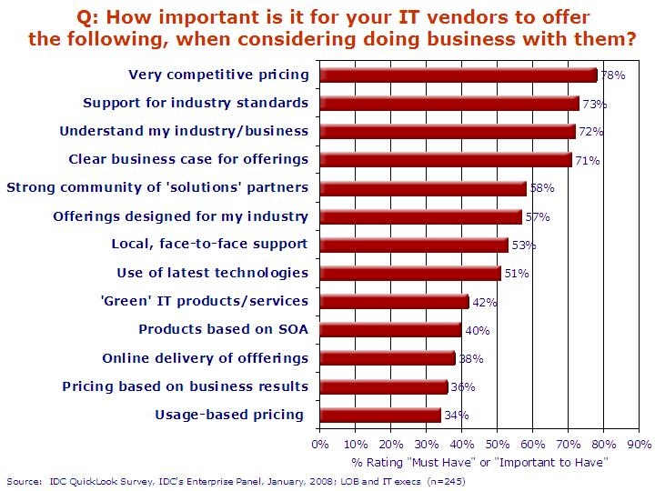
What to expect from the Cloud?
Help users with their IT challenges
Make things less painful

Slide 4
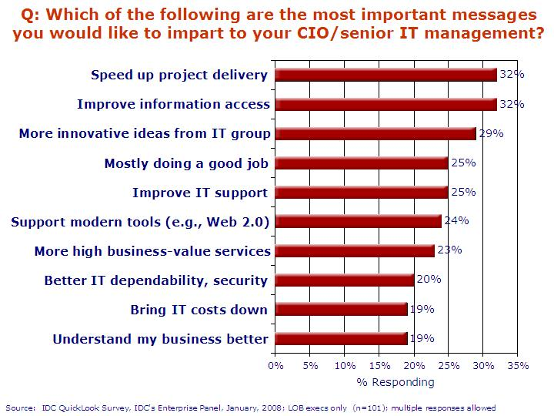
And expect more…
It is not only about cost but being
more resilient
quick to respond to opportunities and risks

Slide 5
Opportunities for Cloud
What is that we can get from cloud database that we always wanted?
Much more efficient and (cost) effective sharing and collaboration
Collaborate with
partners and users who are in the cloud
by sharing and exchanging data and capabilities
in order to
quickly create much greater set of capabilities
react to opportunities and threats much faster
Managing your data in the cloud make it easier than ever

Slide 6
Traditional Way of Sharing/Collaboration
MyPartner.com
API
MyOrganization.com
API
MyOtherPartner.com
API

Slide 7
The Cloud Eco System
MyOrganization.com
MyPartner.com
MyOtherPartner.com

Slide 8
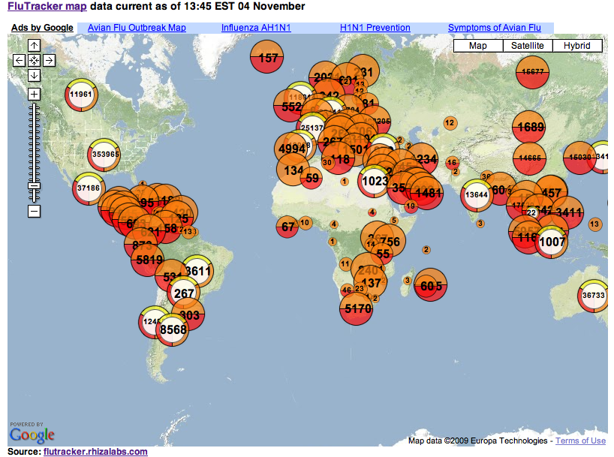
Emergency Response
FluTracker
Scipionus.com

Slide 9
Impediments for Cloud

Slide 10
Security
Security
Privacy
Compliance
Trust
Risk/Benefit
Reference implementations
Open conversations
Pre-certification of cloud implementations
Some may not be in the (public) cloud in a foreseeable future

Slide 11
www.nec-labs.com

